Slide 1
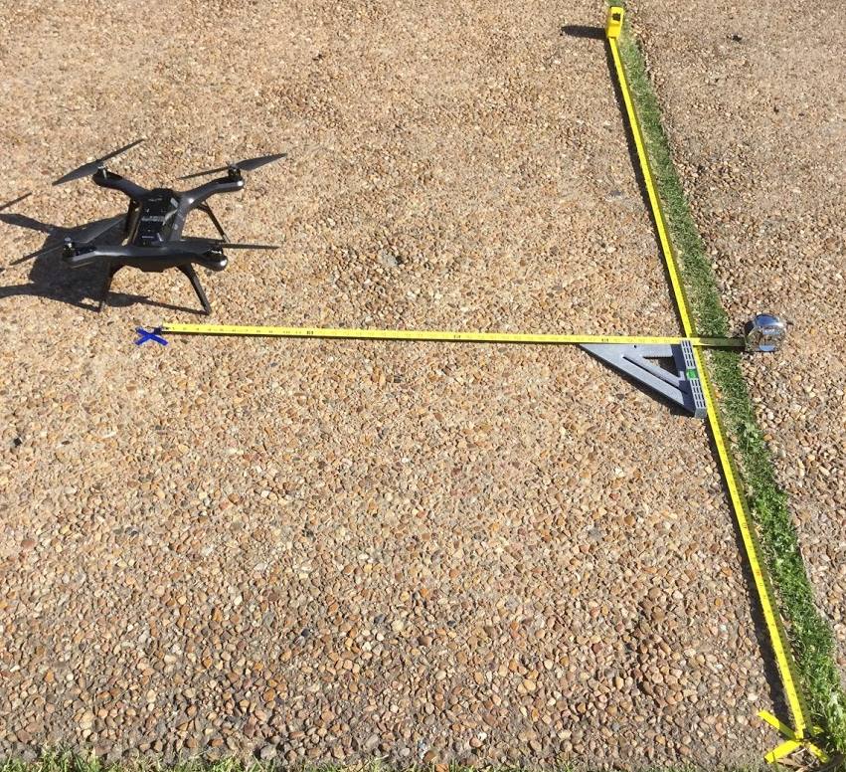
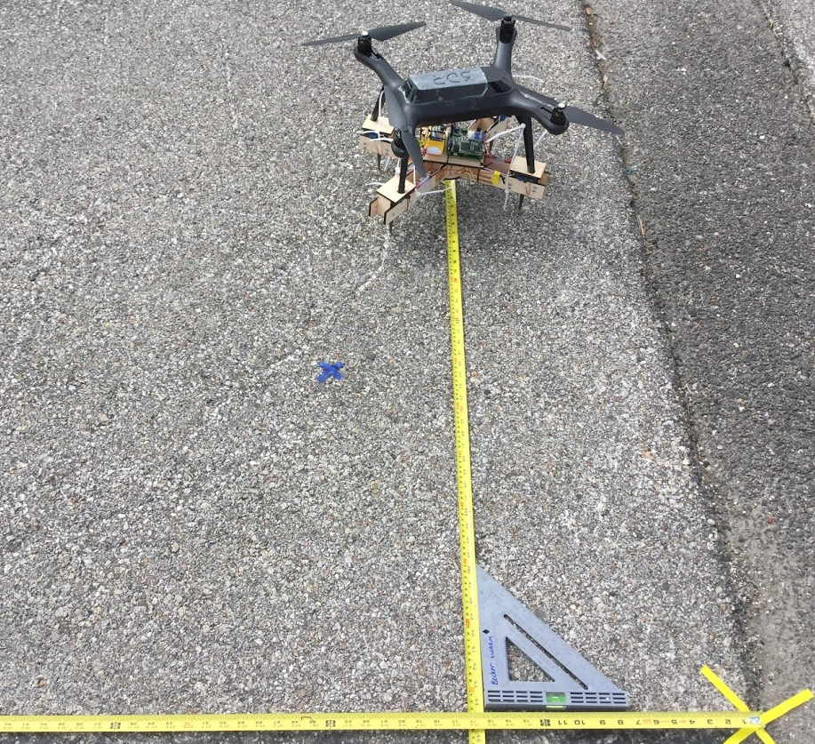
Autonomous Landing without Sensor Platform
Autonomous Landing with Sensor Platform
a.
b.
Landing Location
Landing Location
Goal location
Goal location
Origin of the coordinate system (0,0)
Origin of the coordinate system (0,0)

